Slide 1
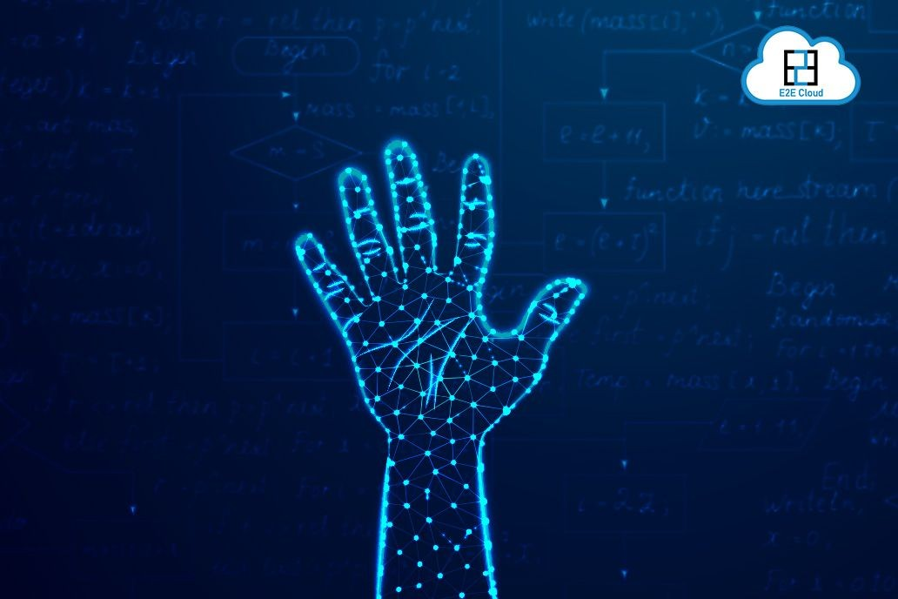
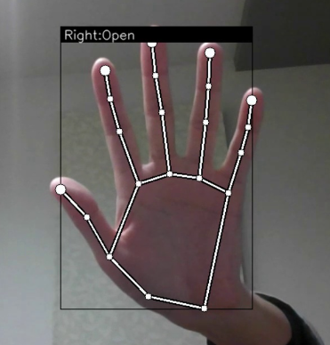
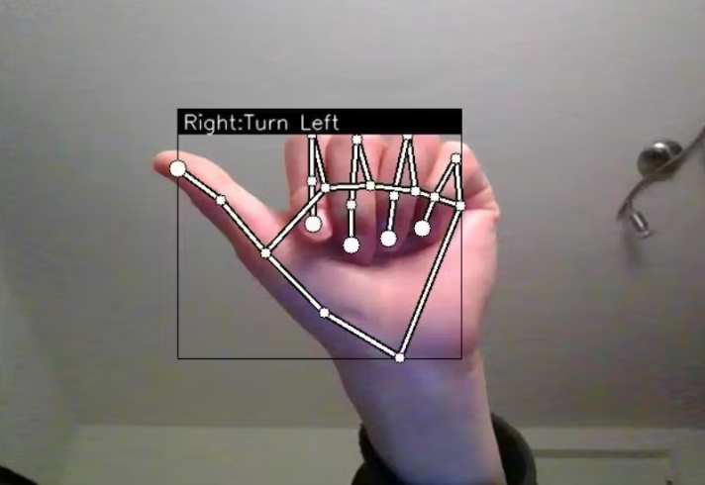
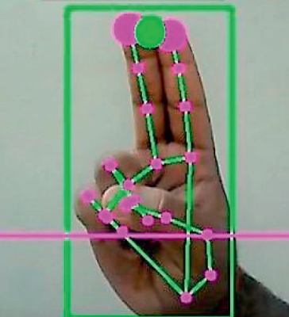
Hand Gesture Recognition Software
Mahak Soni (0827CS201127) Kanishk Chauhan (0827CS201112) Khushboo Sen (0827CS201114) Mayank Solanki (0827CS201134)
Department Of Computer Science, Acropolis Institute Of technology and research
Abstract
Methodology
Results
Developing a solution for Gesture and voice enabled commands for operating Laptops/PCs for frequently used operations such as saving a file, exit application, print command, system shut down etc.
PROPOSED ALGORITHM
Initialization of Camera: The camera is utilized through an image as the user's finger moves in the camera window, it is essential to correlate the resolution of the system screen with the resolution of the camera window being used. So, it becomes important to determine how many pixels are moved on the actual screen if the user moves by 1 pixel in the camera window.
Mapping and Extraction of all Hand Gestures: All the different gestures are going to be used acquisition toolkit in order to capture the user's moving finger. A minimum of 15 frames per second must be the camera's capture rate.
Co-relating the Resolution of the Camera Window and Screen: Because the cursor will move across the entire screen are allocated binary numbers for mapping. Mediapipe package is used for extraction of different landmarks of the hand which is used to recognize gestures. Hand detection is done by the subtraction method which is easy and effective to detect the hand region from the original image. The binary numbers given are useful in finger and palm segmentation.
Recognition and Execution of Hand Gestures: Finally, after successful mapping and extraction of different landmarks of the hand meaningful hand gestures are recognized and executed. This is done with the help of both OpenCV and Mediapipe modules. Depending on how many and what kinds of fingers are found, hand gestures can be anticipated. What fingers are detected depends on the content of the fingers. For example, if five fingers are detected it is classified as a neutral gesture, if two fingers are detected it is classified as a move cursor gesture, if the right finger is pulled down it is classified as a right click, etc.
IMPLEMENTATION
Camera: Using the Python computer vision library OpenCV, the video capture object is created, and the webcam will begin to capture video. The webcam then captures the frames and passes the ones to the AI virtual machine.
Video Capture: It basically captures an image of a finger, which one is up, and based on the information found in the library it performs the mouse functionality accordingly.
Hand Movement: Mouse Features Using Computer Vision to Determine Hand Gestures and Hand Tip Detection Cursor Moving: the index and middle fingers are up for the Moving Function.
Left Button Click: Left button click is made possible by wide opening the index finger and dragging it onto the file or folder.
Right Button Click: Wide opening the middle finger and dragging it onto the file or folder to explore more activities on it enables the right button to click.
Scroll Up/Down: The computer is designed to accomplish the mouse operation of scrolling up and down by merely pinching, which is done by connecting the tips of the index and middle fingers to the screen's scroll bar.
Gesture recognition can be seen as a way for computers to begin to understand human body language. Compared to primitive user interfaces, such as keyboard and mouse, it builds a richer bridge between computers and humans.
The user is facilitated with the control section for the entire process in which they can arrange the position of the hand at the center of ROI under consideration, the variation of palm position and respective command generation, etc can be effectively facilitated by means of the user interface.
Introduction
Conclusion
For any user, authenticated by face recognition, few gestures or voice commands could be defined for frequently used tasks- save, exit, print, screen-lock, screen unlock, system shut down, system restart. Save, print and exit operations are context sensitive meaning that it is applicable for current application. For example if word document is open and the gesture for save is done then the document will saved, if print voice command is given then printer dialog will open etc. Similarly a gesture or a voice command could be defined for close/exit which will close the current application. If no application is opened then it will work as system shut down. It is similar to Alt+F4 key press functionality on windows PC.
Hand gesture recognition is of great importance for human-computer interaction (HCI) because of its extensive applications in virtual reality and sign language recognition etc. The human hand is very smaller with very complex articulations compared with the entire human body and therefore errors can be easily affected.
Acknowledgements
We would like to extend our heartfelt gratitude to our computer science and engineering department for giving us this great opportunity to work on this project.
We would also like to express our sincere gratitude to Prof. Gajendra Chauhan for his valuable guidance and kind supervision throughout the course of this project.

